Slide 1
Session 1
Unit 1: Disaster Preparedness
OHCC
SERT Basic Training
Notes:
Welcome to OHCC SERT Basic Training. We thank all of you for your commitment to maintaining or becoming an Emergency Response Team (ERT) member. Before we move forward, we want to make sure everyone understands the difference between CERT and SERT. The CERT program is part of FEMA and applies nationally to cover responders across multiple jurisdictions. SERT is customized for OHCC. While SERT follows the general direction of CERT, some areas just do not apply to OHCC.

Slide 2
Course Preview
Session 1 Unit 1: Disaster Preparedness;
Unit 2: SERT Organization.
Session 2 Unit 3: First Aid Operations, Part 1
Session 3 Unit 4: First Aid Operations, Part 2;
Unit 5: Disaster Psychology.
Session 4 Unit 6: Fire Safety and Utility Controls;
Unit 7: Light Search and Rescue.
SERT Basic Training Unit 1: Disaster Preparedness 3/25/2022
2
Notes:
There will be 4-sessions which are each about 2-hours. During these classes we will be reviewing specific areas in the CERT Basic Training Participant Manual of August 2019. We will not cover all these materials. We have eliminated some of the reading as is does not pertain to us here in OHCC.

Slide 3
Session 1 - Unit 1 Objectives
Describe the functions of SERT, discuss your role as a SERT volunteer, and explain how SERT fits into our community’s emergency preparedness structure.
Describe the types of hazards most likely to affect our community and their potential impact on people, health, and infrastructure.
Prepare ourself and our family for potential disasters our community may face, including learning to create a family disaster plan and emergency preparedness kit.
PM 1-1
SERT Basic Training Unit 1: Disaster Preparedness 3/25/2022
3
Notes:
As you have read there are many functions to which ERT members can respond. Our focus will be on responding within OHCC.
Describe the types of hazards we could be called upon to help.

Slide 4
Engaging the Whole Community
Whole Community approach to emergency preparedness seeks to engage the full capacity of society.
Relationships and social connections are the foundation for a more resilient community that can bounce back after a disaster.
Neighbor-Helping-Neighbor strengthens relationships and provide a framework for organizing community preparedness efforts.
PM 1-4
SERT Basic Training Unit 1: Disaster Preparedness 3/25/2022
SERT Basic Training Unit 1: Disaster Preparedness
4
Notes:
The best way to make our job easier is to get ourselves, our family and others within OHCC prepared. While the ERT members will respond, the Neighbor-Helping-Neighbor (NHN) team will be the resource to help educate our community members. The Townhall safety presentations will also be another source of community education.

Slide 5
Get Involved
Preparedness requires active participation from all:
  Talk to friends and family about hazards.
  Ask about emergency planning outside the home.
  Make sure those in charge have a plan.
Training provides skills needed to help others and keeps skills current:
  SERT program provides training, practice, and connection to others.
  Participate in drills and exercises.
  Talk to friends and family about volunteering.
PM 1-5
SERT Basic Training Unit 1: Disaster Preparedness 3/25/2022
SERT Basic Training Unit 1: Disaster Preparedness
5
Notes:
ERT members and others within SERT need to be active in the community. ERT members will train and participate in drills for a disaster, so our job requires us to stay current.

Slide 6
Type of Disasters
Natural (e.g., earthquakes, wildfires, floods, extreme heat, hurricanes, landslides, thunderstorms, tornadoes, tsunamis, volcanic eruptions, winter storms).
Technological & Accidental (e.g., hazardous material spill, power plant accident), Considering what to expect from disruption of services.
PM 1-6
SERT Basic Training Unit 1: Disaster Preparedness 3/25/2022
SERT Basic Training Unit 1: Disaster Preparedness
6
Notes:
Our training purposes will focus on earthquakes. While there are other natural disasters that technically occur, as we prepare for a major earthquake, we will be prepared to handle most other situations.
Technological and Accidental hazards may occur which could result in loss of power or other services, which would be the same type of disruptions that could occur following an earthquake.

Slide 7
Infrastructure Damage
Resources will be applied to the highest priority need:
  SERT will address initial damage assessment
  Police will address incidences of grave public safety.
  Firefighters will suppress major fires.
  EMS personnel will handle life-threatening injuries.
PM 1: 7-8
SERT Basic Training Unit 1: Disaster Preparedness 3/25/2022
7
Notes:
ERT members will always be SECONDARY to 911 professional responders. ERT members step in when 911 responders are not available.

Slide 8
Home Hazards
Gas line ruptures from water heaters or ranges displaced by shaking, water, or wind.
Damage from falling contents books, dishes, or other cabinet materials.
Risk of injury or electric shock from displaced appliances and office equipment.
Fire from faulty wiring, overloaded plugs, frayed electrical cords.
PM 1-9
SERT Basic Training Unit 1: Disaster Preparedness 3/25/2022
8
Notes:
Hazards following an earthquake may contain all the above. Our job is to
#1 Keep ERT members safe and
#2 to help others within OHCC get to safety.

Slide 9
Preparing for a Disaster((2 of 2)
Know local hazards, alerts, warning systems, evacuation routes, and sheltering plans.
Have the skills to evaluate the situation quickly and take effective action to protect yourself.
Get involved by participating in training and volunteer programs.
PM 1-10
SERT Basic Training Unit 1: Disaster Preparedness 3/25/2022
9
Notes:
Being prepared will help in saving life and to help minimize property damage. You should all have the San Diego County Emergency, Quake Feed and the American Red Cross emergency apps on your cellular device. If you do NOT have these, please let us know and we will arrange to help you download these.
You maybe called upon to quickly evaluate a situation; this will require practice. ERT members will have a Practice Drill annually as well as a safety class throughout the year so we can keep our skills current. Also remember every 2-years you need to re-certify for the Red Cross Adult First Aid, CPR/AED and the Stop-the-Bleed courses.

Slide 10
Protective Actions
Assess situation.
Decide to stay or change locations.
  This is a critical early decision in disasters.
Seek clean air and protect breathing passages.
Protect from debris and signal if trapped.
Remove contaminants.
Practice good hygiene.
PM 1: 18-19
SERT Basic Training Unit 1: Disaster Preparedness 3/25/2022
10
Notes:
First and foremost is to maintain your personal safety. Here are just some of the areas we will cover during our training sessions.

Slide 11
Sheltering
Shelter in place: sealing a room
  Identify internal room.
  Stay for several hours.
  Store supplies.
Shelter for extended stay:
  Stay for several days or up to 2 weeks.
  Store emergency supplies.
Mass care or community shelter:
  Take 3-day disaster kits.
  Shelters provide most supplies.
PM 1: 19-20
SERT Basic Training Unit 1: Disaster Preparedness 3/25/2022
11
Notes:
Within OHCC, sheltering is something the residents often ask about. They always want to know the location of where they should evacuate and how to get there. WE DO NOT KNOW! This question is situational and will be made by San Diego County or Oceanside Fire/Police. If SERT can get everyone in OHCC to be prepared to self-sustain for 72-hours (3-days), it will make our job so much easier.

Slide 12
SERT Disaster Response
SERT members respond post-disaster by:
  Treating life-threatening injuries until professional assistance is available.
  Helping disaster survivors cope with their emotional stressors.
  Locating and turning off utilities, if safe to do so.
  Conducting light search and rescue operations.
PM 1: 23
SERT Basic Training Unit 1: Disaster Preparedness 3/25/2022
12
Notes:
SERT ERT members will be able to help in many ways. Treating injuries and helping survivors will be covered in Session 2 & 3. Utilities and Light Search and Rescue will be covered in Session 4.
A special note here: SERT members primary role is NOT to turn off utilities. This is the homeowner's responsibility!

Slide 13
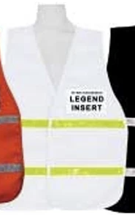
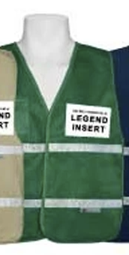
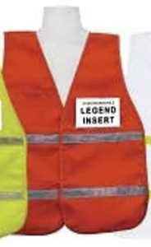


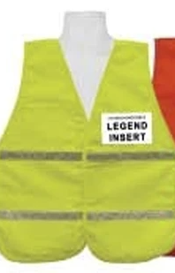
Personal Protective Equipment (PPE)
OHCC SERT Back-Pack Inventory List
Weight of backpack/supplies 6 lbs +/-
SERT Vest
Duct Tape
Work Gloves
Goggles
Helmet - Hard Hat
Red Cross Hand Crank Flashlight
Pen & Pad
N-95 Masks (3)
Scissors
Personal First Aid Kit
Whistle
Yellow Caution Tape
Nitrile Gloves (10-Pairs)
Stop the Bleed Kit Tourniquet -1
16 oz Water Bottle - 2
Stretch Gauze Bandage -4
4x4 Sterile Gauze Pads - 4
Triangular Bandage -2
Utility Knife
Space Blanket-2
CPR Face Shields - 2
Blue Tape - 1
4x4 Stop-the-Bleed Gauze -1
White-Command
Green-ERT Members
Orange-Drivers
Dress in layers
Sturdy shoes or work boots
Red-First Aid
Blue-Reservists
Yellow-Safety Coordinator
PM 1: 25
SERT Basic Training Unit 1: Disaster Preparedness 3/25/2022
13
Notes:
If you have not already received your SERT backpack with your PPE, you will shortly. Every ERT member--at a minimum--will have the SAME resources in their backpack. It is your responsibility to maintain these items. If items need to be replaced, please contact SERT via the OHCCSERT@gmail.com. You can add more to your backpack, if you wish, just know that this will add weight, and you may be carrying your pack for several hours.

Slide 14
Protection for Disaster Workers
SERT members are generally protected by:
  “Good Samaritan” laws.
  Volunteer Protection Act of 1997.
  Relevant State statutes.
PM 1: 25
SERT Basic Training Unit 1: Disaster Preparedness 3/25/2022
14
Notes:
In California, the Good Samaritan laws covers CERT/SERT responders. The law is posted on the SERT website ohccsert.com, and you should read it to fully understand the law.

Slide 15
Session 1
Unit 1 Summary (Unit 1)
You should now be able to:
  Identify roles and responsibilities for our community preparedness;
  Describe types of hazards that affect our community, people, health, and infrastructure;
  Undertake personal and organizational preparedness actions;
  Describe functions of SERT.
PM 1: 28
SERT Basic Training Unit 1: Disaster Preparedness 3/25/2022
15
Notes:
We are off to a great start. This is what we have already learned.

Slide 16
Unit 2: SERT Organization
OHCC
SERT Basic Training

Slide 17
Session 1 - Unit 2 Objectives
Describe the SERT organizational structure.
Explain the Incident Command System (ICS) and how SERT operates within this structure.
Describe the 9-step on-scene size-up process.
Describe how to use OHCC SERT documents.
PM 2-1
SERT Basic Training Unit 2: SERT Organization 3/25/2022
17
Notes:
The SERT organization is very similar to the CERT organization, with SERT being customized for OHCC. In this Unit we will review: the SERT organization, the structure, and the duties and responsibilities of SERT ERT members. We will also review how to size-up a disaster situation and what documents you will need to be familiar with to properly record what you discover and report accurately.

Slide 18
Objectives for On-Scene Management
Maintain the safety of SERT ERT members.
Provide clear leadership and organizational structure.
Improve effectiveness of rescue efforts
Identify scope of incident.
Determine overall strategy.
Deploy resources.
Document actions and results.
PM 2-2
SERT Basic Training Unit 2: SERT Organization 3/25/2022
18
Notes:
When disaster strikes, we all will be shaken. Our training will help us all be more prepared than most in OHCC. Remember our #1 priority is your individual safety! SERT--as you will see--has a specific organizational structure. Through these training sessions you will see: the overall strategy for providing aid, the resources available to ERT members, how to document actions, and the results we should accomplish.

Slide 19
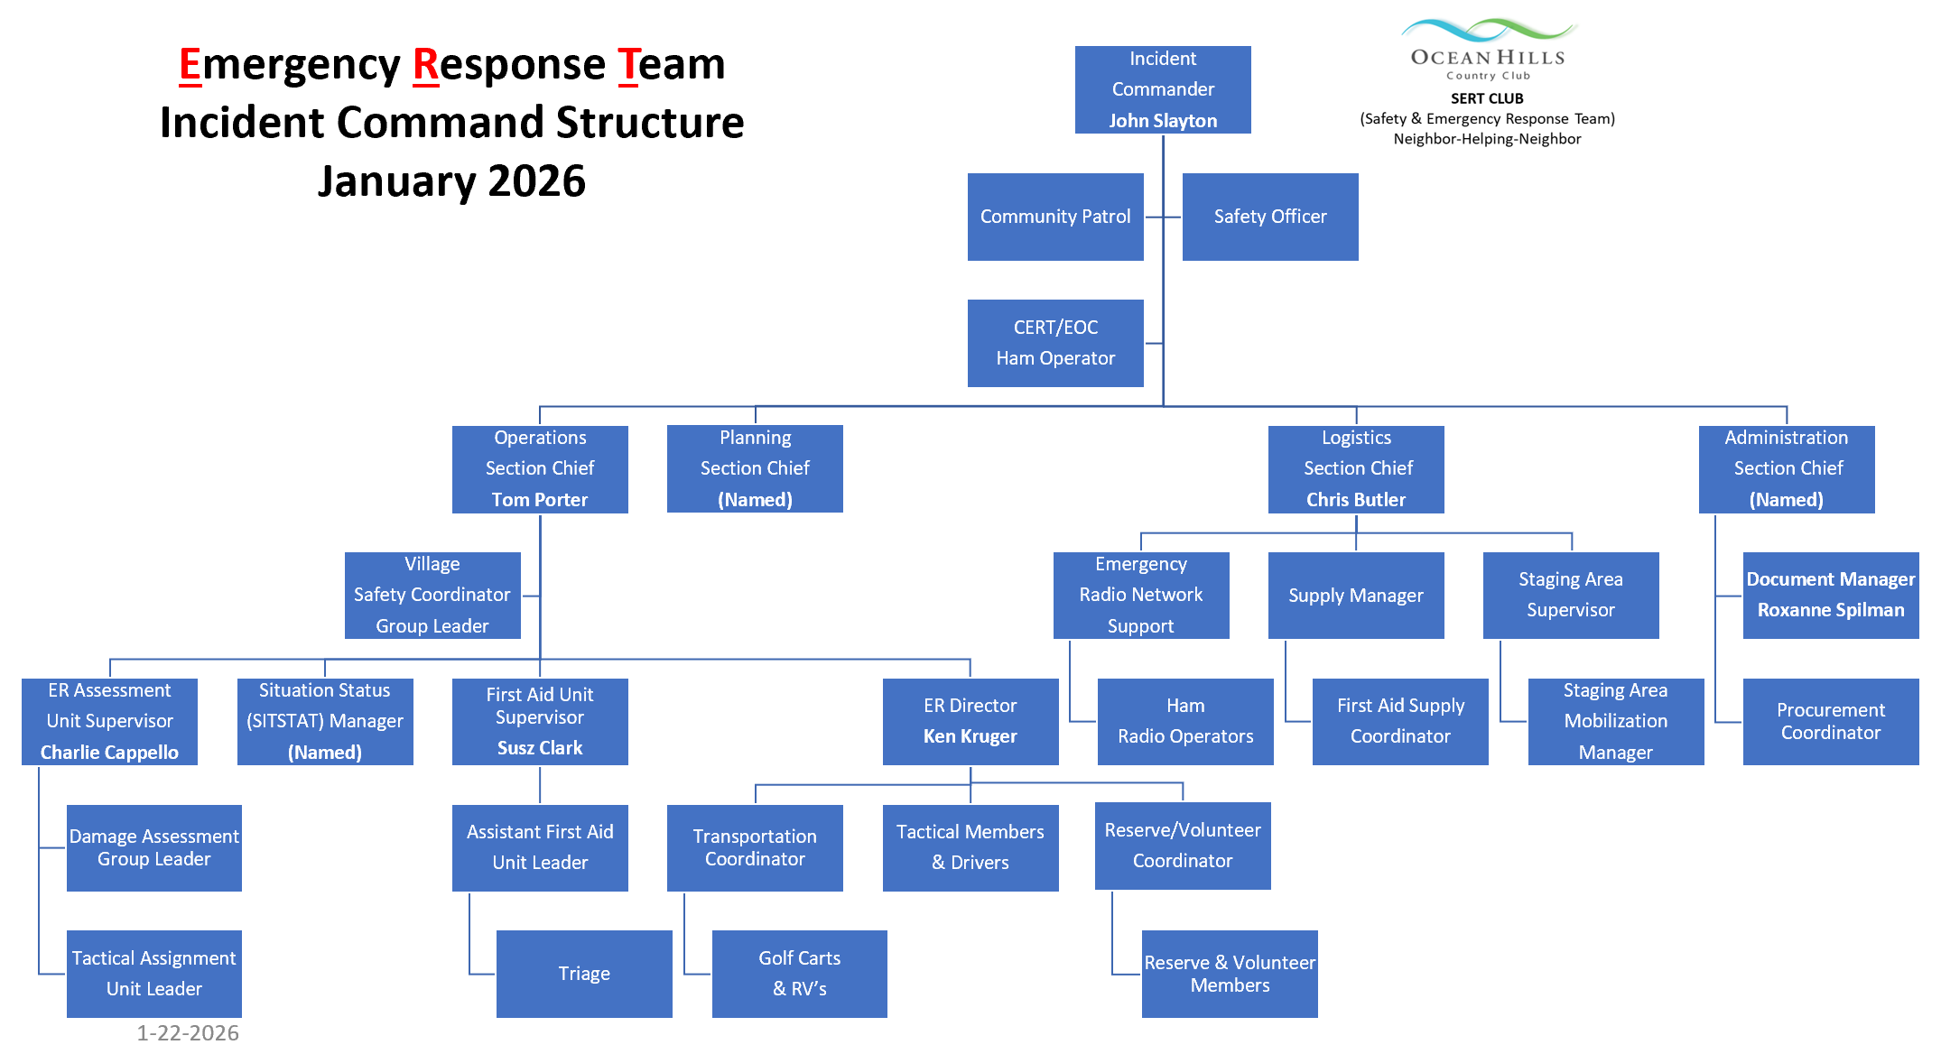
Notes:
The SERT Incident Command Structure is “Command & Control” for a very good reason. In an emergency we need to be disciplined and follow instructions as seconds manner in provided first aid. In your binders is a job descriptions of all these positions. You need to familiarize yourself with all of these. In an emergency you may be called upon to step into another role.

Slide 20
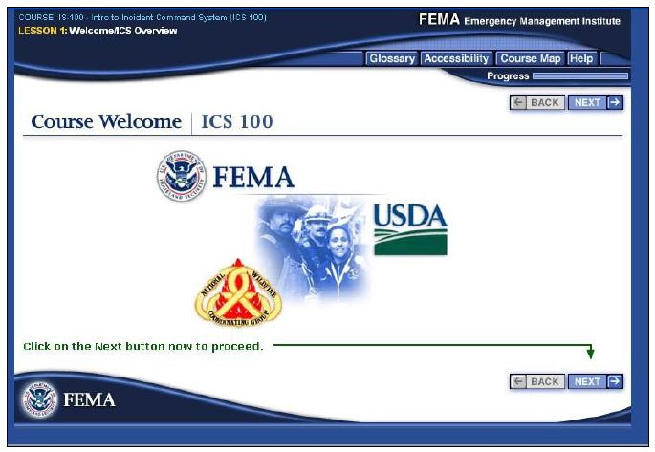
NIMS Implementation
(National Incident Management System)
Ability to work together:
IS-100: Introduction to ICS.
IS-200: Basic Incident Command System for Initial Response.
IS-700: Introduction to NIMS.
PM 2-6
SERT Basic Training Unit 2: SERT Organization 3/25/2022
20
Notes:
Within FEMA the CERT program has very clear guidelines for everyone to follow in an emergency. It is CRITICAL that we all understand these guidelines.
IS-100 is Required for all ERT Members. IS-200 is required for all Command, Director, and Supervisors and strongly recommended for all ERT members. IS-700 is required for Command Staff and recommended for Director and Supervisors.

Slide 21
SERT Mobilization
SERT - First take care of ourselves, your families and your home.
Proceed to staging area.
SERT is flexible and evolves based on new information.
PM 2-8
SERT Basic Training Unit 2: SERT Organization 3/25/2022
21
Notes:
During a mobilization you will “probably” receive a text message to turn on your radio and to report to the staging area. If for some reason the text message system is down, and you feel a relatively strong earthquake (4.5+), turn on your radio and someone will respond.
The OHCC staging area will be in the Overflow Parking Lot across the street from the clubhouse. This is the “plan” however we must be flexible to respond to current situations.

Slide 22
SERT Radio Control
Ability to communicate in an emergency
Process SERT follows
Radio Control
Radio Operations
Radio Practice
Radio Etiquette
Oceanside EOC Communications
SERT Basic Training Unit 2: SERT Organization 3/25/2022
22
Notes:
Following a major earthquake land lines and cell towers may be offline. As SERT responds, your 2-way radio is the way we will communicate. So, when an emergency of significant incident occurs, ERT will be activated. When ERT members are available, they check into the radio control operator. The radio control operator checks-in the members and has them report to the staging area. The radio is programed with multiple operating frequencies, but the Primary channel 1 is used for the main communications. This is the channel that we use for our monthly check-ins. This gives us radio practice for a real emergency. The radio use has limitations. Only one person can talk at one time, so when someone is talking and finishes, he/she says “over”. The radio control operator helps coordinate the conversations. Additionally, SERT can communicate with Oceanside EOC on OHCC status via a Ham Radio.

Slide 23
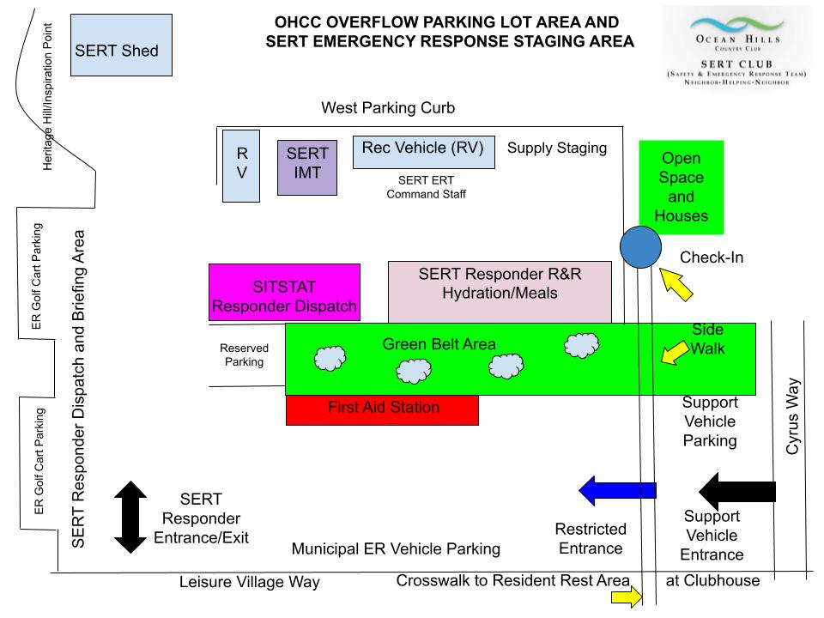
Staging Area
SERT Basic Training Unit 2: SERT Organization 3/25/2022
23
Notes:
Included in your reading material is a diagram of the staging area, how it will be set up and the functions within each areas.

Slide 24
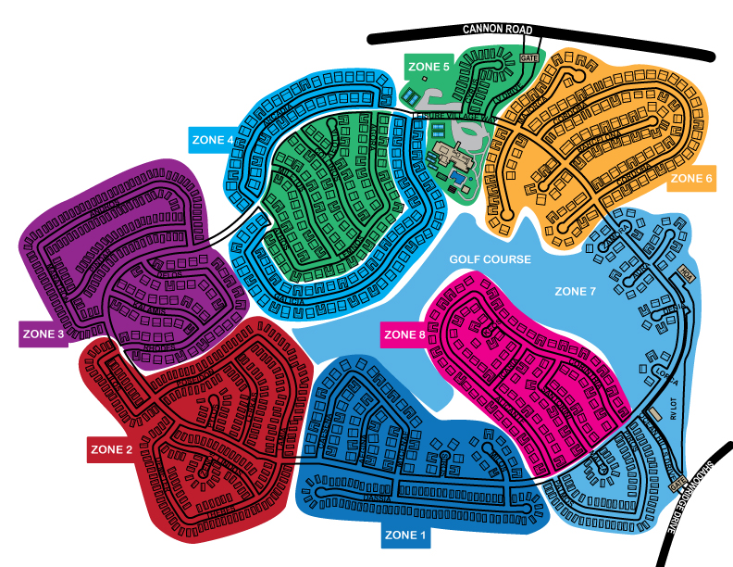
Zone Map
SERT Basic Training Unit 2: SERT Organization 3/25/2022
24
Notes:
Following an activation, we may be called upon to complete a Life and Property Damage Assessment of OHCC. We have divided OHCC into 8-Zones. Each Zone is color coded and have the similar number of structures and/or areas to check. Based on the type of event the Zones that will be assessed may vary.
If you are assigned to do the assessment for a Zone, you will be provided will a clip board that will have a map of the Zone you are to assess and a list of all street addresses within the Zone.
Note in the case of Zone 5 they will assess the Clubhouse, sport courts and the front gate. Zone 7 will also assess the Golf Course, back gate, RV lot and HOA Office area.

Slide 25
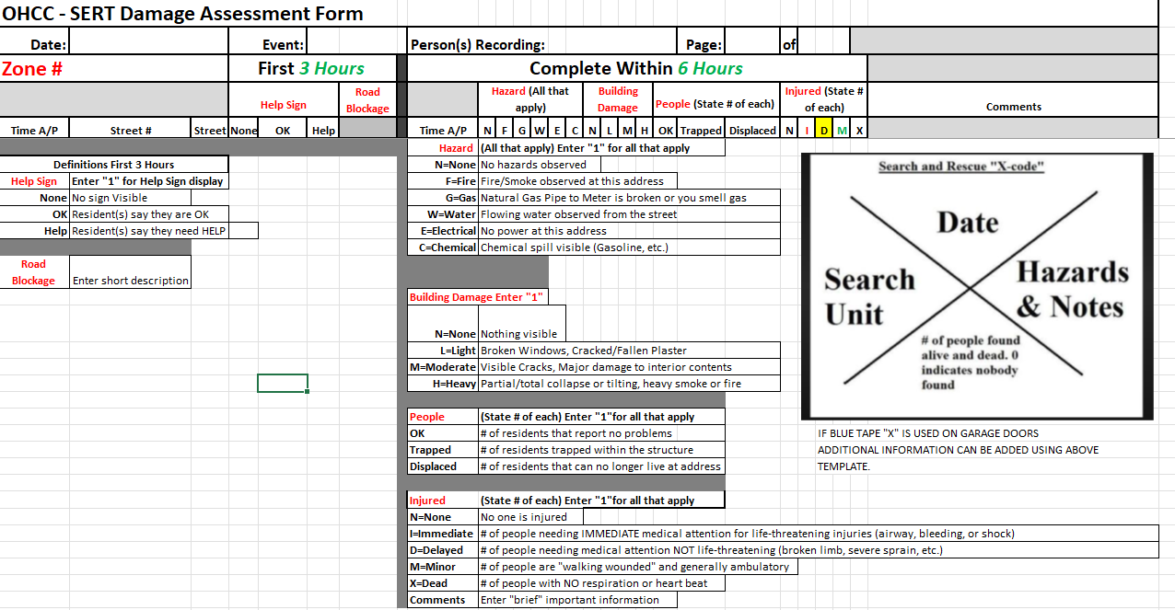
Damage Assessment Form Instructions
SERT Basic Training Unit 2: SERT Organization 4/11/2021
25
Notes:
In the front of your manual, you received a copy of instructions of how to fill out the SERT Damage Assessment Form. We will cover how to fill out this form during an upcoming “tabletop” training exercise. You will note there are two parts of the assessment form. The first part is to be filled out within the first 3-hours of the assignment. Basically, to assess if the street is SAFE, are there any road blockages, fires, downed streetlights, and later record if the OK/Help sign is visible and where the HELP is shown. You then report your results to the SitSat.
If you are assigned to perform and complete assessment, you use the same form as was originally used and complete the further assessment within 6-hours of the assignment. As some of the situations you encounter may be serious you will be to radio in these observations to radio control so they can be prioritized for further assistance.

Slide 26
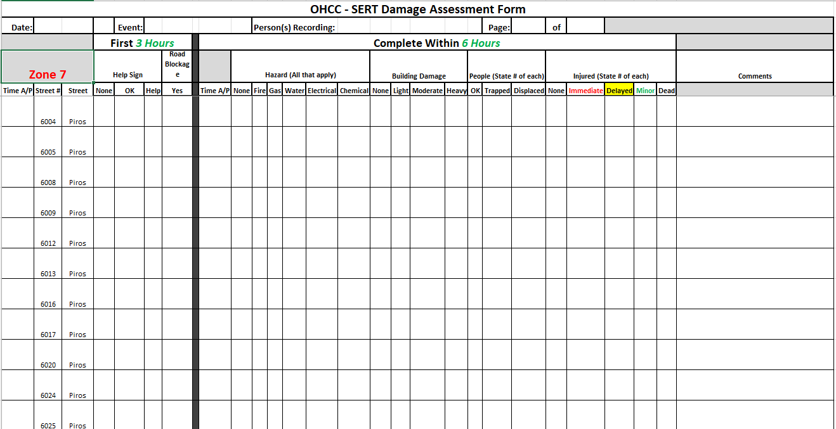
Damage Assessment Form (Sample)
Note forms are printed display the actual street address based on the Zone Map.
SERT Basic Training Unit 2: SERT Organization 3/25/2022
26
Notes:
This is a copy of a portion of the Damage Assessment form for Piros in Zone 7. As you can see each street address has its own row so you can easily record your assessment.

Slide 27
On-Scene Size-up
Gather Facts.
Assess and Communicate Damage.
Consider Probabilities.
Assess Your Own Situation.
Establish Priorities.
Make Decisions.
Develop Plan of Action.
Take Action.
Evaluate Progress.
PM 2: 8-10
SERT Basic Training Unit 2: SERT Organization 3/25/2022
27
Notes:
Sizing up the situation is very important. While this is a 9-step process, it can be achieved very rapidly with practice. In the manual on pages 2-9 & 2-10 are the questions you will need ask yourself.

Slide 28
Rescuer Safety
Rescuer safety = 1st priority.
Heavy damage = No rescue.
Moderate damage = Locate, assess, evacuate.
Light damage = Locate, assess, continue size-up, and document.
PM 2:10-11
SERT Basic Training Unit 2: SERT Organization 3/25/2022
28
Notes:
We cannot say this enough; YOUR SAFETY is the #1 priority for all ERT members. There will be times when the best decision will be to do nothing!
If a structure is highly damaged and you think it is unsafe … then it is UNSAFE! You cannot help others if you are injured or trapped in the process.

Slide 29

Documentation
Command Staff
  Document's situation status:
    Incident locations;
    Access routes;
    Identified hazards;
    Support locations.
Section Chiefs
  Provide Incident Commander with information.
PM 2-12
SERT Basic Training Unit 2: SERT Organization 3/25/2022
29
Notes:
Command staff will need your reports to communicate with emergency responders. Command will have access--even if the power is out and cell towers are down--via the HAM radio system. Information is key and it must be reported in the same format that responders will process the information. It will help everyone prioritize the situation for the proper response.

Slide 30
Documentation Forms
Damage Assessment.
Personnel Resources Sign-In.
SERT Assignment Tracking Log.
Communications Log.
Equipment Inventory.
PM 2-13
SERT Basic Training Unit 2: SERT Organization 3/25/2022
30
Notes:
There are several documents that will be utilized during a response. WRITE IT DOWN!
When you get to the staging area, check-in so we know you are here. Wait for your assignment. Report back upon assignment completion so we know you have returned. We don’t want to have to implement a search & rescue for you unless warranted.

Slide 31
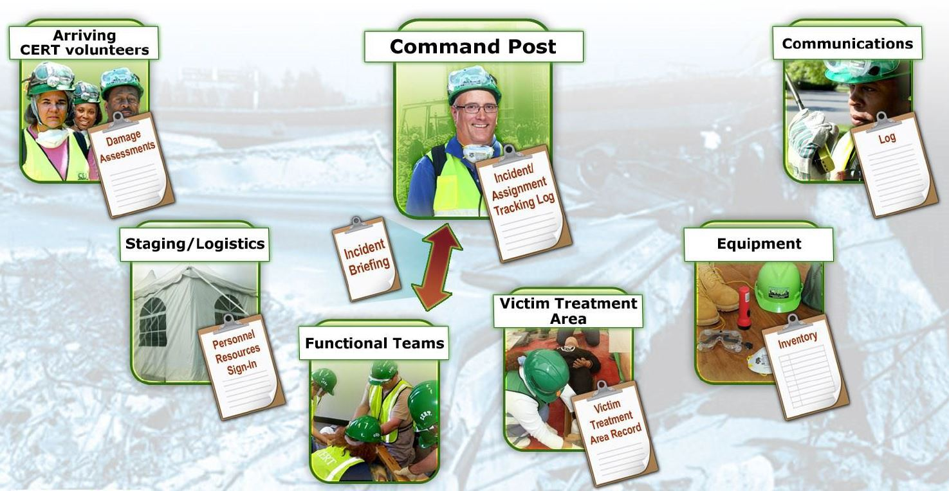
Documentation Flow (5 of 5)
PM 2-13
SERT Basic Training Unit 2: SERT Organization 3/25/2022
31
Notes:
Documents will flow in multiple directions. Everything ultimately flows up to the Incident Command who will always have the final say on what action is required. The Incident Commander’s word is always FINAL!

Slide 32
Session 1
Unit 2 Summary (Unit 2)
ICS provides flexible means of organization.
Ask “Is it safe to attempt the rescue?”
Document and communicate information to all SERT levels.
Provide Command Post with ongoing information about damage assessment, group status, and needs.
Command Post documents and tracks situation status.
PM 2-25
SERT Basic Training Unit 2: SERT Organization 3/25/2022
32
Notes:
Today we have learned the following.

Slide 33
Homework Assignment (Unit 1)
Review the detailed information in Unit 1 and Unit 2 of the Participant Manual.
Examine your home for hazards and identify ways to prevent potential injury.
Read Session 2
  Unit 3 First Aid Operations, Part 1.
SERT Basic Training Unit 2: SERT Organization 3/25/2022
33
Notes:
Before the next Session, please briefly review what we covered today and look at your own home for potential hazards. Then read the materials for Session 2.
Thank you and have a great week!

